Slide 1

CoolTShirts
Attributions
Sampath Gonnuru | 04.22.2020

Slide 2
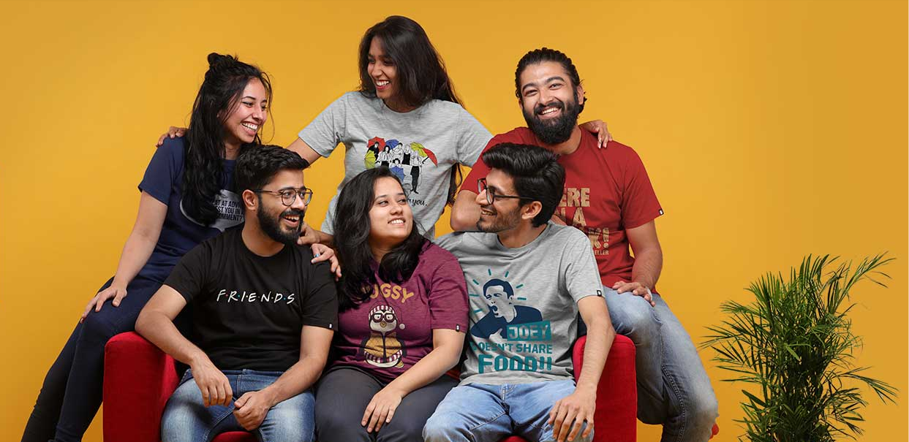
About
CoolTShirts, an innovative apparel shop, is running a bunch of marketing campaigns. CoolTShirts sells shirts of all kinds, as long as they are T-shaped and cool.

Slide 3
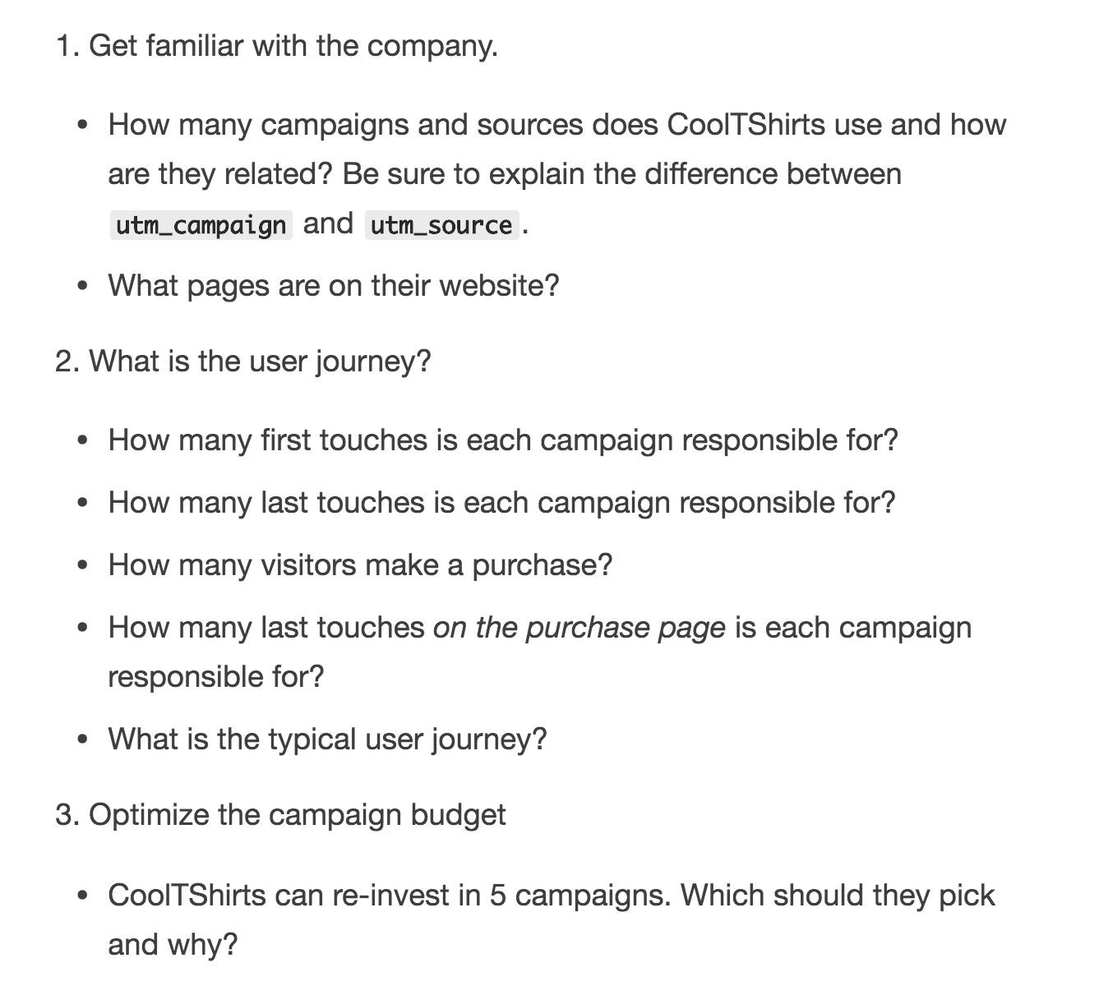
TABLE OF CONTENTS
GET FAMILIAR WITH THE COOLTSHIRTS
WHAT IS THE USER JOURNEY
OPTIMIZE THE CAMPAIGN BUDGET

Slide 4
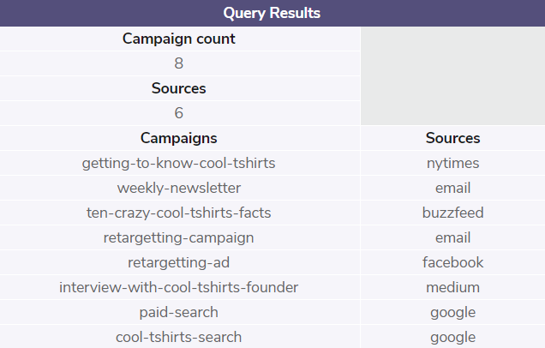
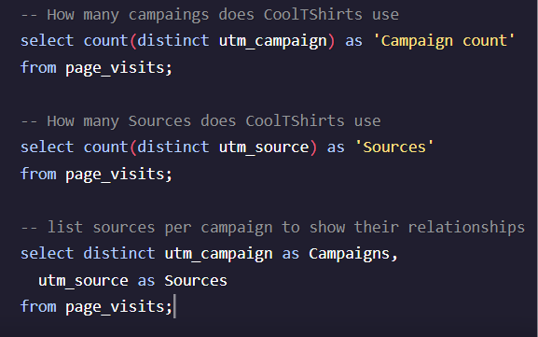
1. GET FAMILIAR WITH COOLTSHIRTS
How many campaigns and sources does CoolTShirts use? Which source is used for each campaign?
A source is the type of communication, like email, or site on which a campaign is shared with prospective customers, like google, Facebook, Medium, Buzzfeed or The New York Times.
A campaign is a specific message designed to elicit a specific response from a specific group of prospective customers.
A source, like email, can run multiple campaigns, like 'retargeting' or 'weekly newsletter'.
The same campaign could be run across multiple sources, although that is not represented in this dataset.

Slide 5
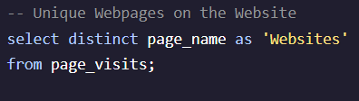
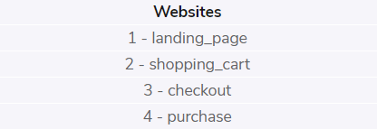
1. GET FAMILIAR WITH COOLTSHIRTS – CONT’D
What pages are on the CoolTShirts website?
Find the distinct values of the page_name column. A simple SELECT DISTINCT query answers this question quickly.
Pages names shown are presumably a subset of actual pages on site and denote the specific page the campaign directed the prospective customer to upon clicking the link in the campaign. For instance, there are no specific 'product_pages' or 'department_pages'.

Slide 6
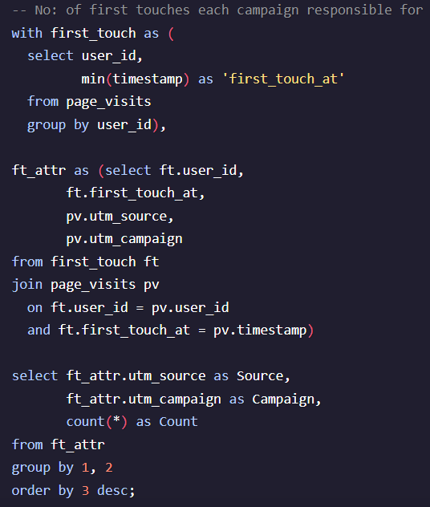
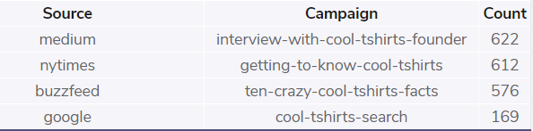
2. WHAT IS THE USER JOURNEY?
How many first touches is each campaign responsible for?
By identifying the timestamps with the MIN date for each user, it is possible to determine which source and campaign first captured the prospects attention and prompted them to click through to the site.
Interesting to note that out of 1,979 unique visitors only 4 campaigns of the 8 active were responsible for first touch.

Slide 7
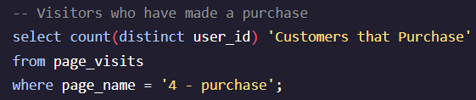
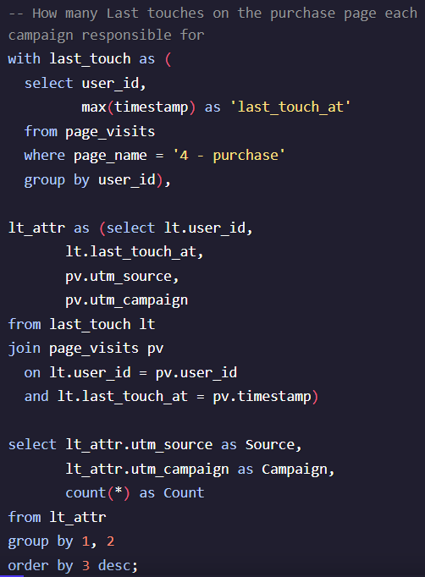
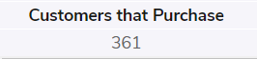
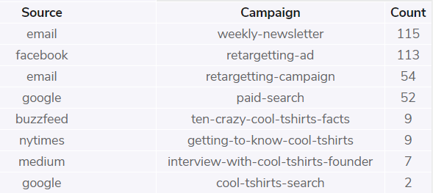
2. WHAT IS THE USER JOURNEY? – CONT’D
How many visitors make a purchase?
Conversion rate from visitor to 'customer' is a solid 18% (361 / 1,979 = 18%)
How many last touches on the purchase page is each campaign responsible for?
By isolating MAX timestamp where the page visited was the 'purchase page' we can identify the sources and campaigns that were responsible for conversion and ultimately revenue for the company.
Again, initial traffic generating campaigns continue to drop in effectiveness

Slide 8
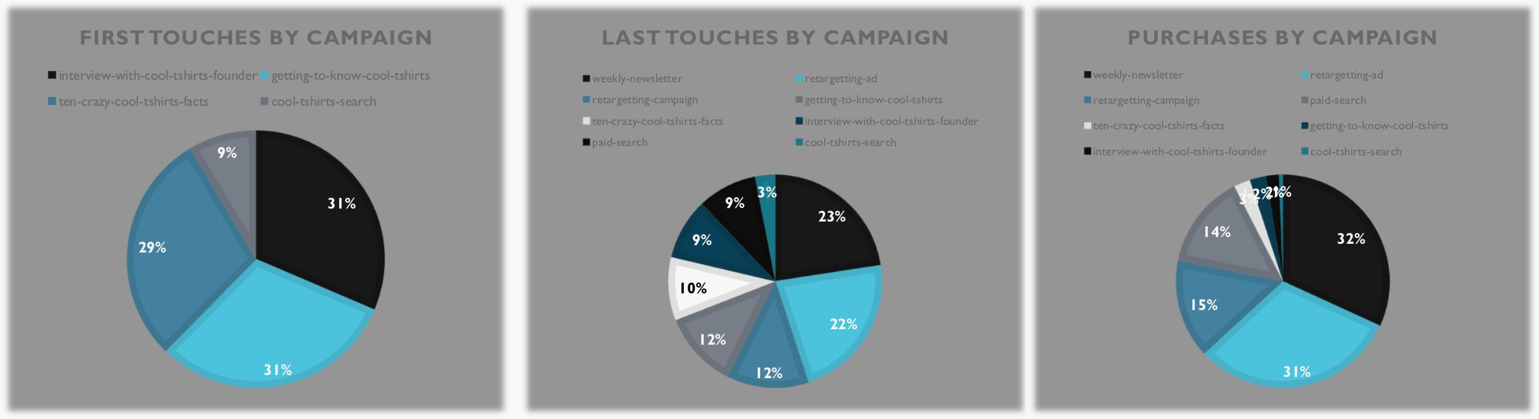
2. WHAT IS THE TYPICAL USER JOURNEY?
'Story' campaigns draw users to site
But, users need additional reminders to stay engaged
And those reminders generate most of the revenue
91% of users first come to the site via one of these 'story' campaigns:
31% of users that came to site via a 'story' campaign don’t return and 'story' campaigns only account for 6% of purchases
The majority of prospects require a 2nd campaign to become purchasing customers.
78% of purchases were generated via email newsletter, email retargeting, or Facebook retargeting ads.
Interview with CoolTShirts Founder
Getting to Know CoolTShirts
Ten Crazy CoolTShirts Facts

Slide 9
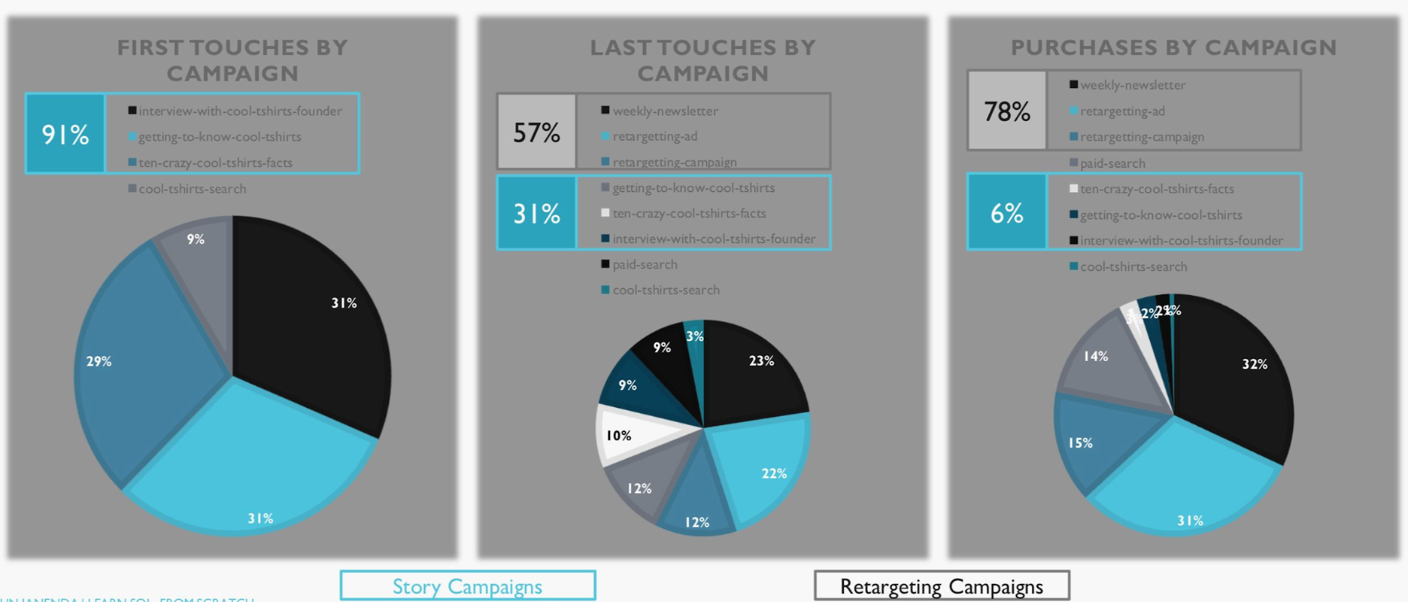
2. WHAT IS THE TYPICAL USER JOURNEY? – CONT’D

Slide 10
OPTIMIZING THE CAMPAIGN BUDGET
Which 5 campaigns should CoolTShirts re-invest in?
Limiting re-investment to 5 campaigns will likely leave money on the table as there are at least 6 high performing campaigns.
If CoolTShirts can only invest in 5, data recommends that all 3 'story' campaigns highlighted in blue are exceptional at generating interest, they should be continued.
In addition, retargeting is critical, so the two remaining campaigns should be based on a retargeting strategy.
Perhaps slightly counter-intuitive, but suggest that weekly newsletter should be discontinued, despite its success, under the assumption that all 'touches' that remind customer of company 'may' be equal.
Suggest continuing the email retargeting campaign and place a premium on email capture as part of journey from story campaign to site as email newsletters and retargeting campaigns account for 47% of sales. Having customer email address is extremely important to conversion. Would have been interesting to see how many email addresses were in the database as compared to visitors.
Further suggest extending retargeting ad campaigns as they have the potential to reach 100% of prospects that interact with site, INCLUDING those that do not provide an email address. Would strongly consider purchasing retargeting ads on additional sites like NYT, Buzzfeed and Medium, if possible, as they generate excellent traffic from 'story' campaigns.

Slide 11
OPTIMIZING THE CAMPAIGN BUDGET
Which 5 campaigns should CoolTShirts re-invest in? – cont’d
Campaign | 1st Touches | % 1st Touches | Last Touches | % Last Touches | Purchases | % Purchases
interview-with-cool-tshirts-founder | 622 | 31% | 184 | 9% | 7 | 2%
getting-to-know-cool-tshirts | 612 | 31% | 232 | 12% | 9 | 2%
ten-crazy-cool-tshirts-facts | 576 | 29% | 190 | 10% | 9 | 2%
cool-tshirts-search | 169 | 9% | 60 | 3% | 2 | 1%
weekly-newsletter | 0 | 0% | 447 | 23% | 115 | 32%
retargetting-ad | 0 | 0% | 443 | 22% | 113 | 31%
retargetting-campaign | 0 | 0% | 245 | 12% | 54 | 15%
paid-search | 0 | 0% | 178 | 9% | 52 | 14%

Slide 12
OPTIMIZING THE CAMPAIGN BUDGET
Rationale for discounted campaigns
A note on the discontinued campaigns
As noted previously regarding weekly-newsletter, would prefer to keep it active, but assuming that possibly any appearance in customer’s inbox will trigger a response and since a newsletter costs ‘something’ to produce, perhaps that money can be spent on increasing retargeting ads to additional sites beyond Facebook (see note on ‘Extra’s’ page regarding traffic by source.
Organic search, presumably generated via SEO activities generates 9% of traffic – not insignificant, but if budget needs to be cut, this is a less effective means of reaching prospects for initial capture, presumably because brand recognition for CoolTShirts is relatively low and there are likely hundreds of competitors in the t-shirt space.
Paid search accounts for 14% of actual purchases, so it is valuable, but only after customers have been introduced to site via ‘story’ campaigns as it does not appear in initial visit data. If something needs to be cut, this is a candidate.

Slide 13
OPTIMIZING THE CAMPAIGN BUDGET
Rationale for discounted campaigns – cont’d
Campaign | 1st Touches | % 1st Touches | Last Touches | % Last Touches | Purchases | % Purchases
interview-with-cool-tshirts-founder | 622 | 31% | 184 | 9% | 7 | 2%
getting-to-know-cool-tshirts | 612 | 31% | 232 | 12% | 9 | 2%
ten-crazy-cool-tshirts-facts | 576 | 29% | 190 | 10% | 9 | 2%
cool-tshirts-search | 169 | 9% | 60 | 3% | 2 | 1%
weekly-newsletter | 0 | 0% | 447 | 23% | 115 | 32%
retargetting-ad | 0 | 0% | 443 | 22% | 113 | 31%
retargetting-campaign | 0 | 0% | 245 | 12% | 54 | 15%
paid-search | 0 | 0% | 178 | 9% | 52 | 14%

Slide 14
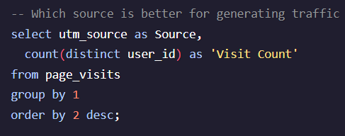
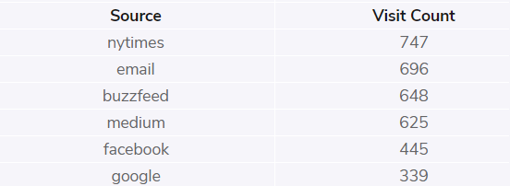
EXTRAS
Retargeting ads should be considered for New York Times, Buzzfeed, and Medium as they all appear better at generating traffic than Facebook or Google.

